Slide 1

PRETERM BIRTH PREDICTION USING MACHINE LEARNING

Slide 2
PROBLEMS For the Baby: Respiratory Issues: Premature infants may have underdeveloped lungs, leading to breathing difficulties like respiratory distress syndrome (RDS). Feeding and Digestive Issues: Difficulties in feeding and an increased risk of necrotizing enterocolitis (NEC), a severe intestinal problem. Immune System Weakness: Premature babies have weaker immune systems, making them more prone to infections. For the Mother Emotional and Mental Health: Mothers of preterm babies may experience anxiety, stress, and postpartum depression due to concerns over their baby's health. Future Pregnancy Risks: A history of preterm birth increases the risk of future preterm deliveries.

Slide 3

SOLUTIONS
Early Identification of High-Risk Pregnancies:
Prediction models assess maternal age, medical history, and biomarkers to detect pregnancies at risk of preterm birth early on.
Better Resource Allocation:
Hospitals can allocate resources for NICU support, while telemedicine ensures regular monitoring in remote areas.

Slide 4
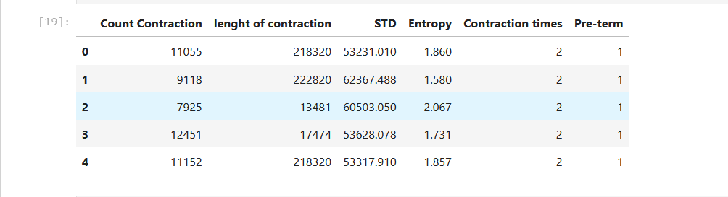
DATASET we had collected dataset from kaggle which consists of Contraction Count: The total number of contractions. Length of Contraction: The duration of each contraction in sec. Entropy: A measure of irregularity in contraction patterns over time. Standard Deviation: A statistic that indicates the variation or dispersion of contraction intervals or durations. Preterm: A binary label indicating whether a birth occurred preterm (before 37 weeks of gestation) or at term.

Slide 5
MODEL BUILDING
Data Collection: Describe the dataset (sources, features collected).
Feature Selection: Selected attributes like contractions, STD, Entropy, etc.
Model Selection: Choose Extreme Gradient Boosting due to its efficiency and high predictive performance on structured data.
Model Training : Split data into training and testing, with validation metrics.

Slide 6
ALGORITHM USED
EXTREME GRADIENT BOOST
XGBoost is a machine learning algorithm, specifically an implementation of the Gradient Boosting technique for decision trees. It’s widely used in machine learning due to its efficiency and high predictive performance on structured data.

Slide 7
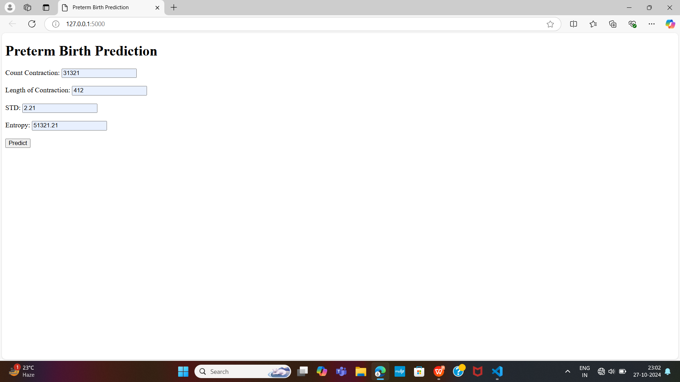
SCREENSHOTS

Slide 8
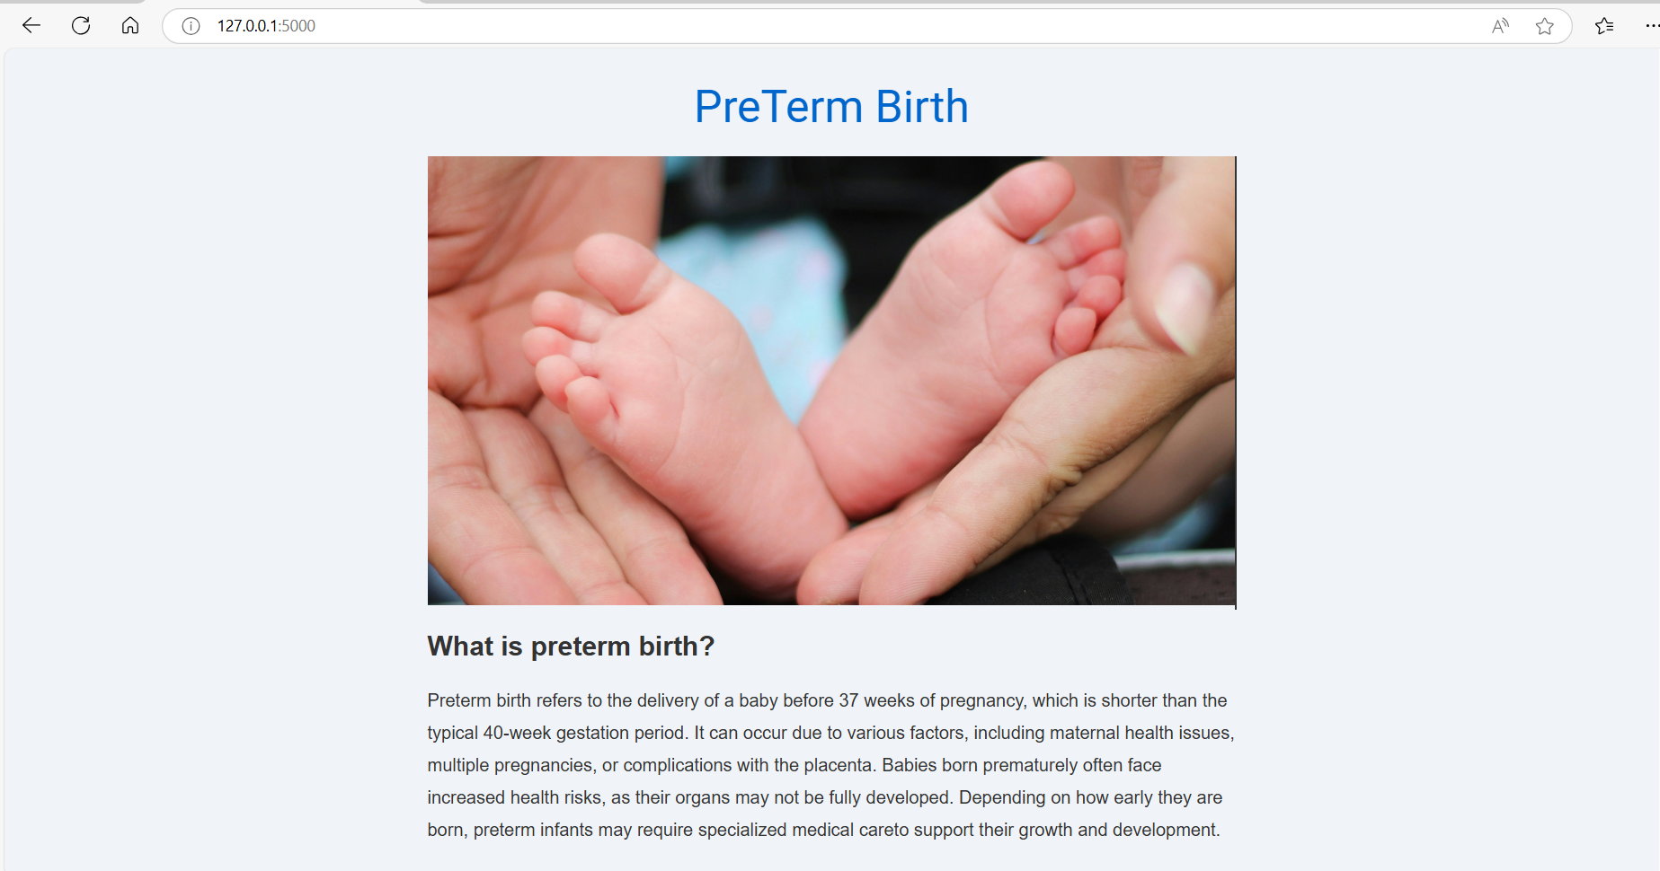

Slide 9
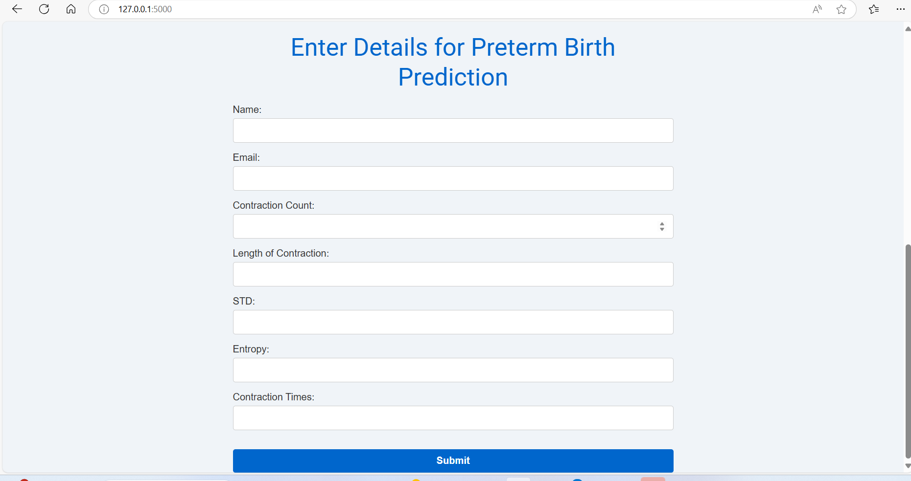

Slide 10
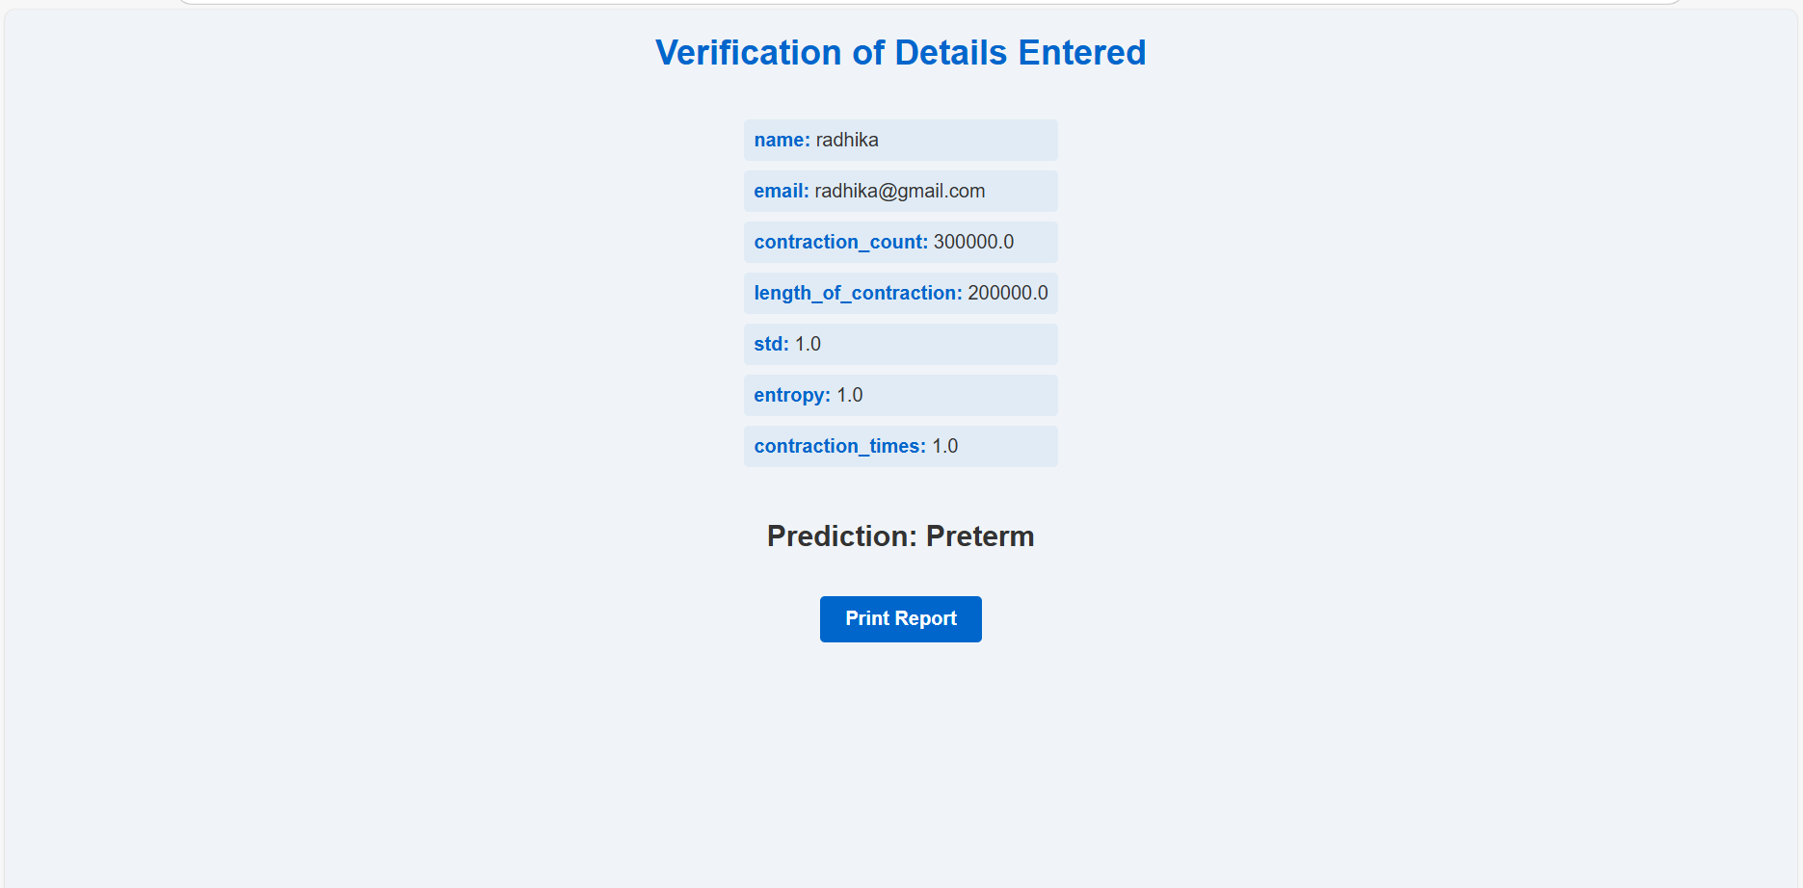

Slide 11
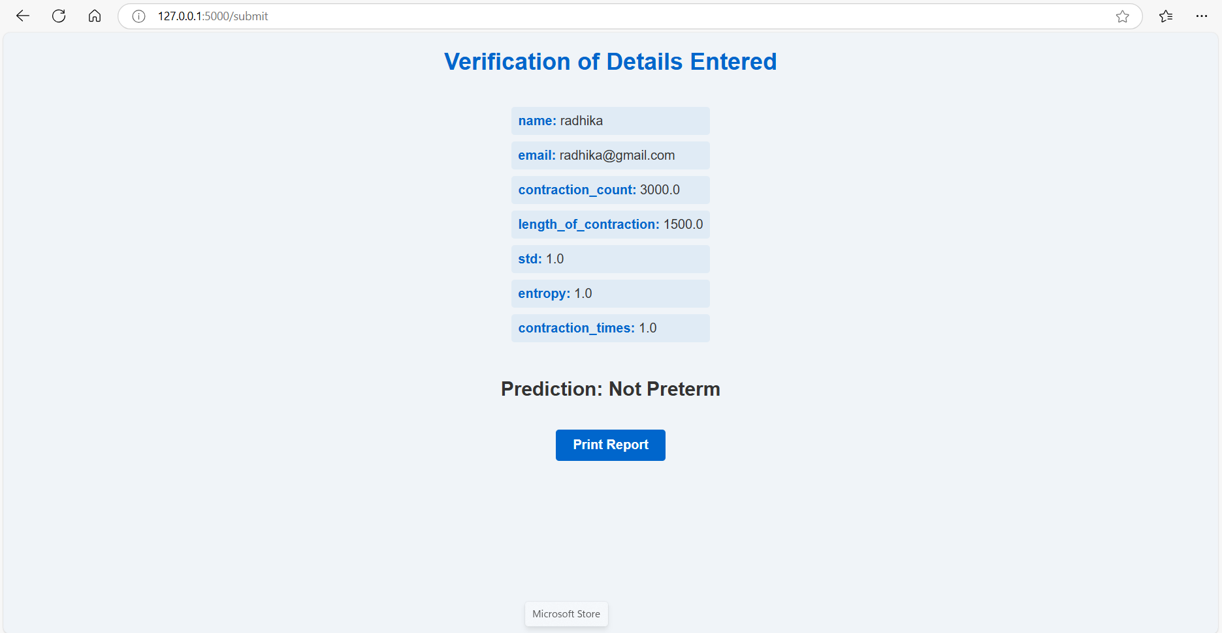

Slide 12
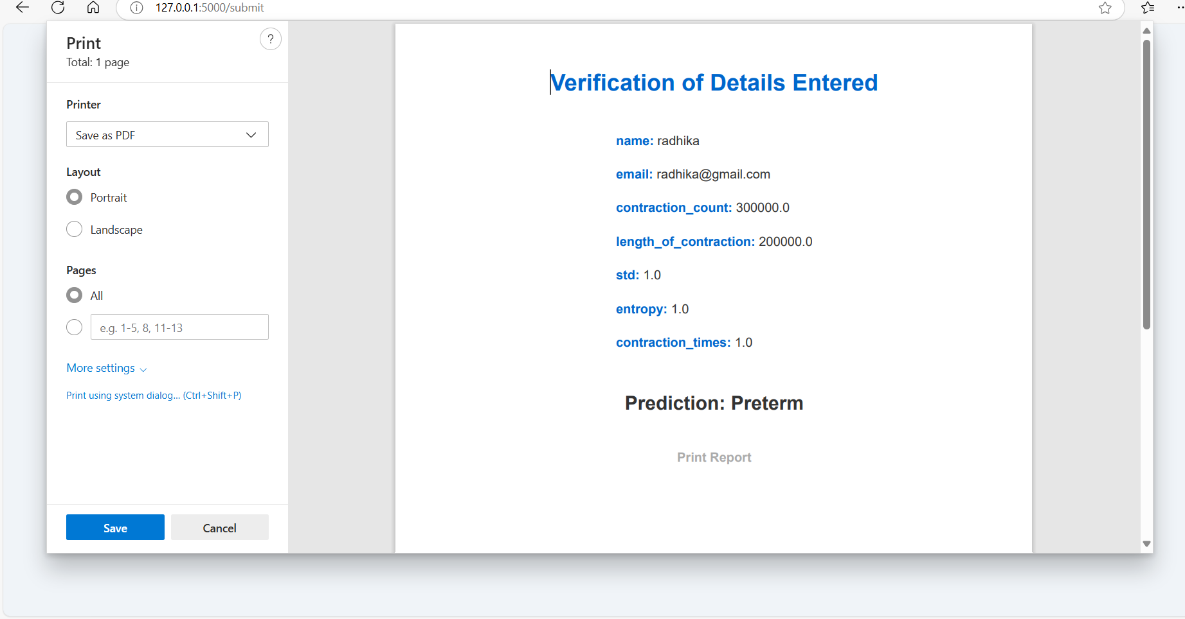

Slide 13
TEAM MEMBERS:
A.RADHIKA REDDY
N.BHARGAVI
M.VANI
K.SUSMITHA

Slide 14
THANK YOU!

